Slide 1
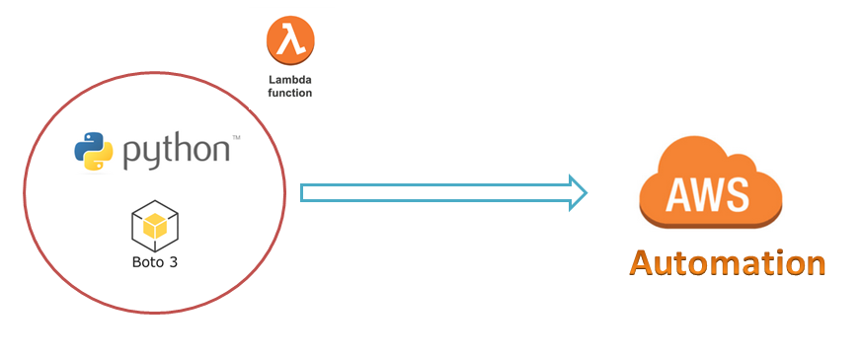
AWS Automation
with
boto3 of Python and Lambda Functions
Boto3 Session Concept
Loop control statements or commands
(break and continue)
Learn how to automate AWS common tasks using boto3 and Lambda

Slide 2

Boto3 Session Concept:
The are two types of Sessions
They are:
Custom Session
Default Session
Loop control statements or commands
(break and continue)
Learn how to automate AWS common tasks using boto3 and Lambda

Slide 3
Thank you

